Slide 1
Introduction to Process Control
Chapter 1
prototype system-blending tank
feedback control
implementation of control
justification of control
‹#›
Notes:
‹#›

Slide 2
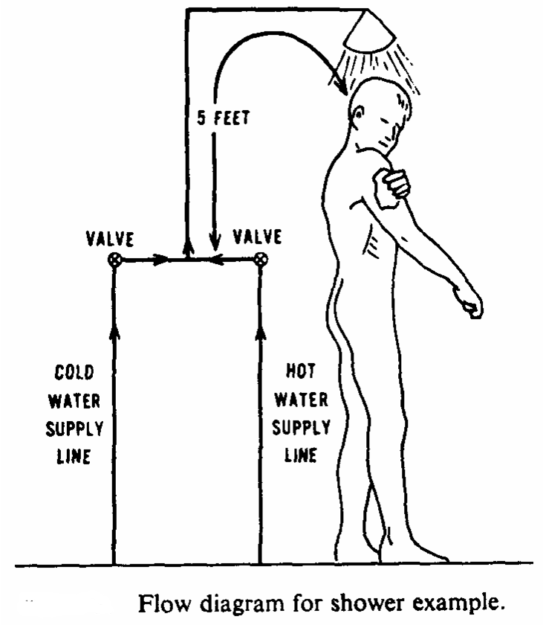
Chapter 1
‹#›

Slide 3
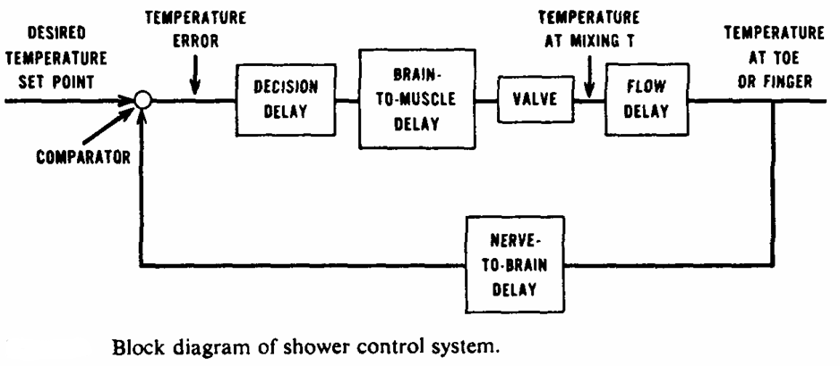
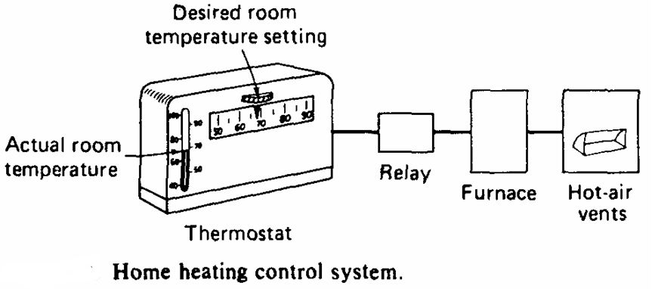
Chapter 1
‹#›

Slide 4
Control Terminology
controlled variables - these are the variables which quantify the performance or quality of the final product, which are also called output variables.
manipulated variables - these input variables are adjusted dynamically to keep the controlled variables at their set-points.
disturbance variables - these are also called "load" variables and represent input variables that can cause the controlled variables to deviate from their respective set points.
Chapter 1
‹#›
Notes:
‹#›

Slide 5
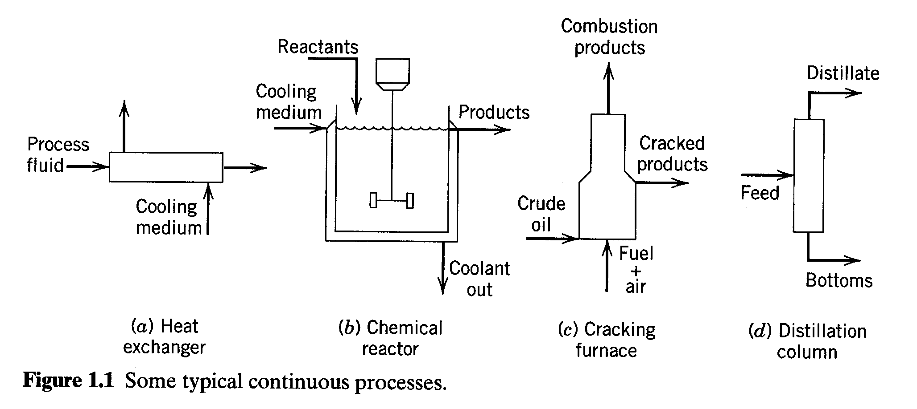
Chapter 1
‹#›
Notes:
‹#›

Slide 6
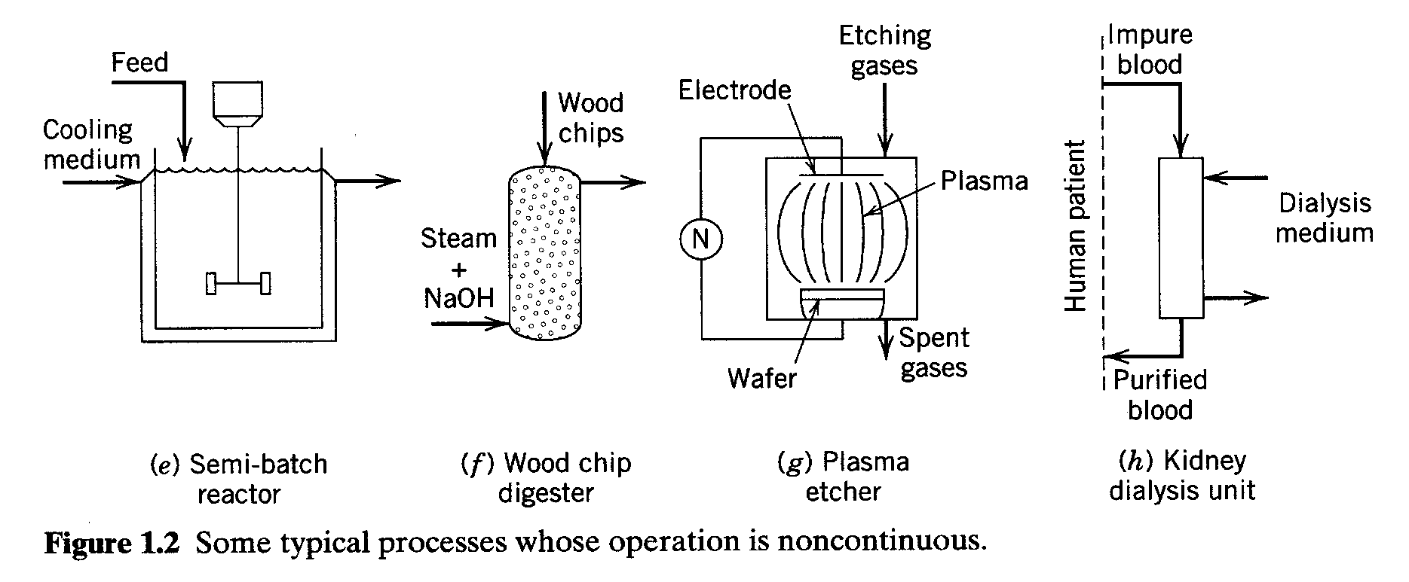
Chapter 1
Chapter 1
‹#›

Slide 7
Control Terminology(2)
set-point change - implementing a change in the operating conditions. The set-point signal is changed and the manipulated variable is adjusted appropriately to achieve the new operating conditions. Also called servomechanism (or "servo") control.
disturbance change - the process transient behavior when a disturbance enters, also called regulatory control or load change. A control system should be able to return each controlled variable back to its set-point.
Chapter 1
‹#›

Slide 8
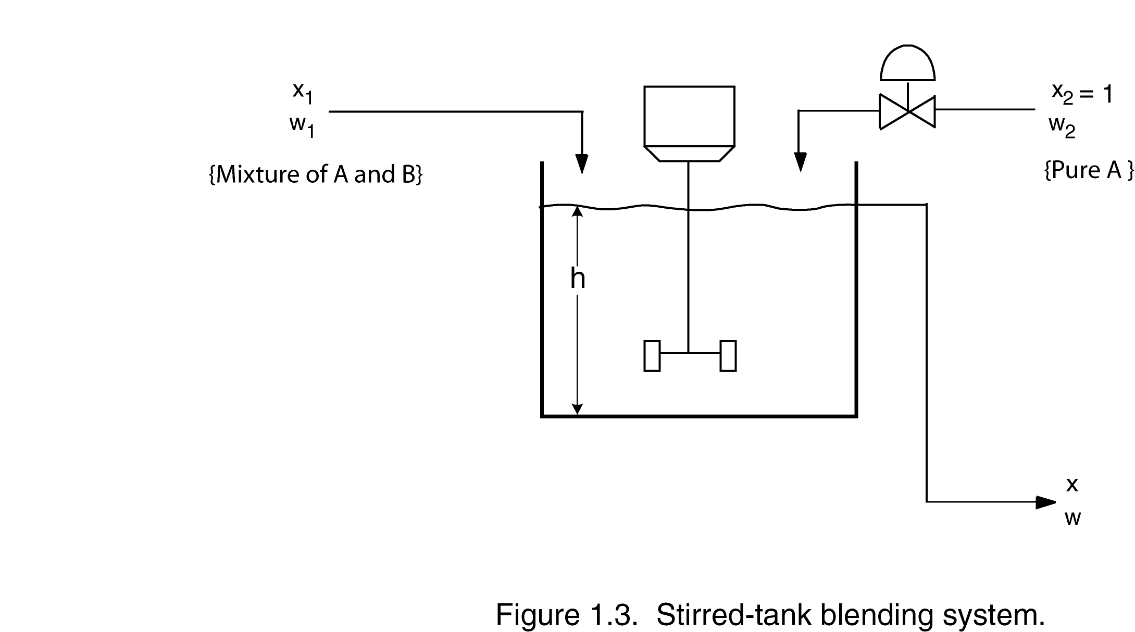
Illustrative Example: Blending system
Chapter 1
Notation:
w₁, w₂ and w are mass flow rates
x₁, x₂ and x are mass fractions of component A
‹#›

Slide 9
Assumptions:
w₁ is constant
x₂ = constant = 1 (stream 2 is pure A)
Perfect mixing in the tank
Control Objective:
Keep x at a desired value (or “set point”) x_{sp}, despite variations in x₁(t). Flow rate w₂ can be adjusted for this purpose.
Chapter 1
Terminology:
Controlled variable (or “output variable”): x
Manipulated variable (or “input variable”): w₂
Disturbance variable (or “load variable”): x₁
‹#›

Slide 10
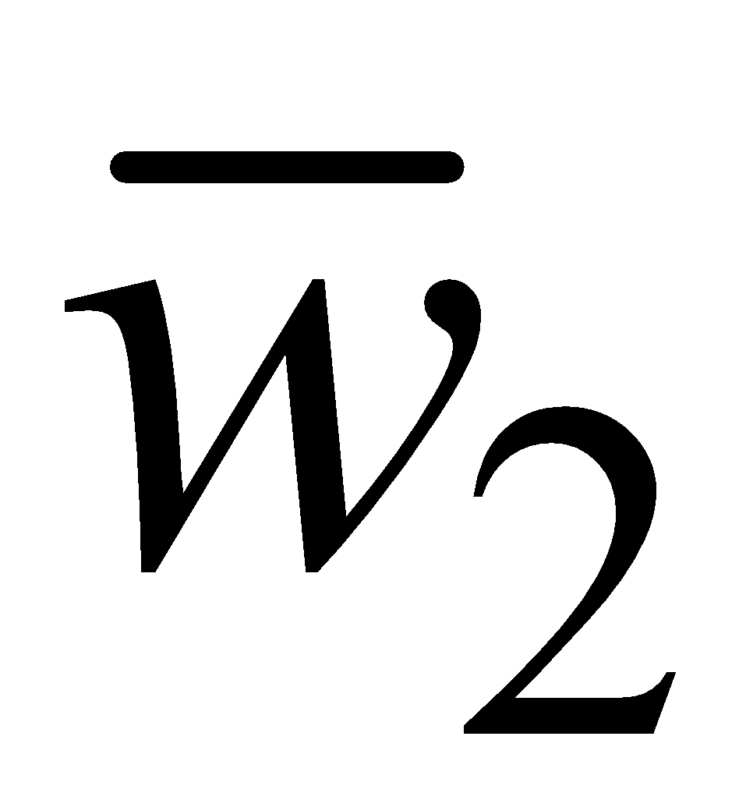
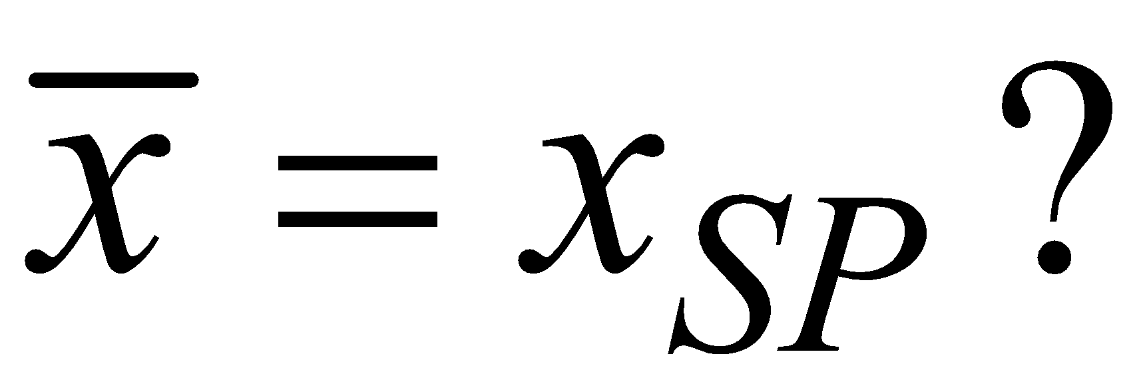
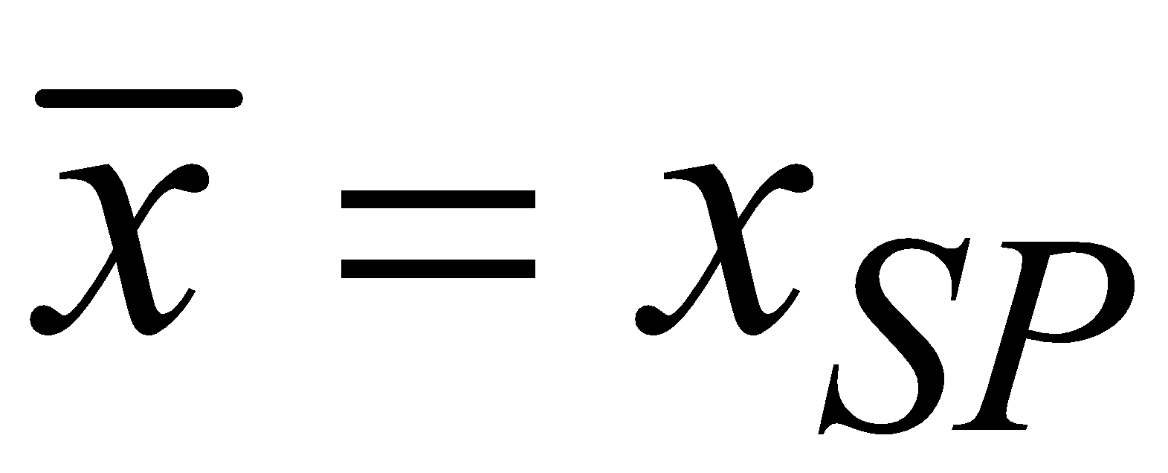
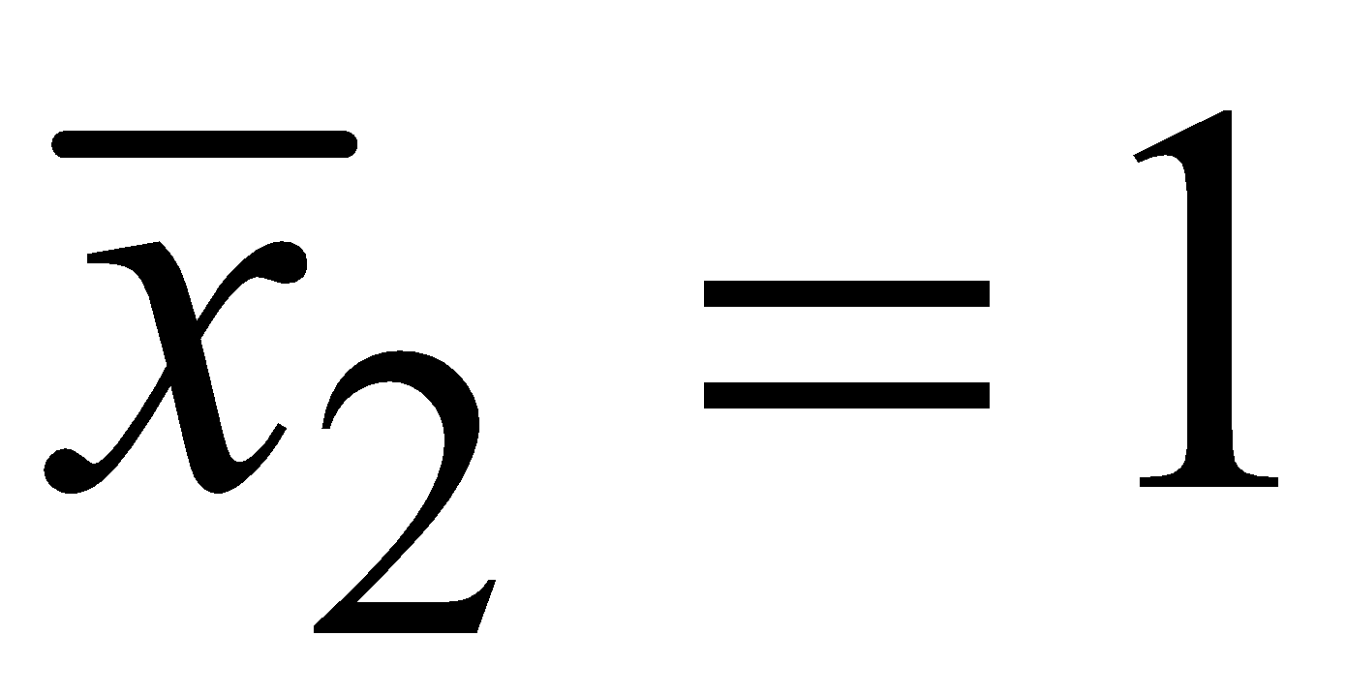
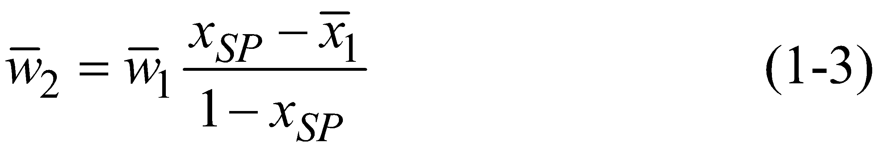
Design Question. What value of is required to have
Overall balance:
Component A balance:
Chapter 1
(The overbars denote nominal steady-state design values.)
At the design conditions, . Substitute Eq. 1-2, and , then solve Eq. 1-2 for :
‹#›

Slide 11
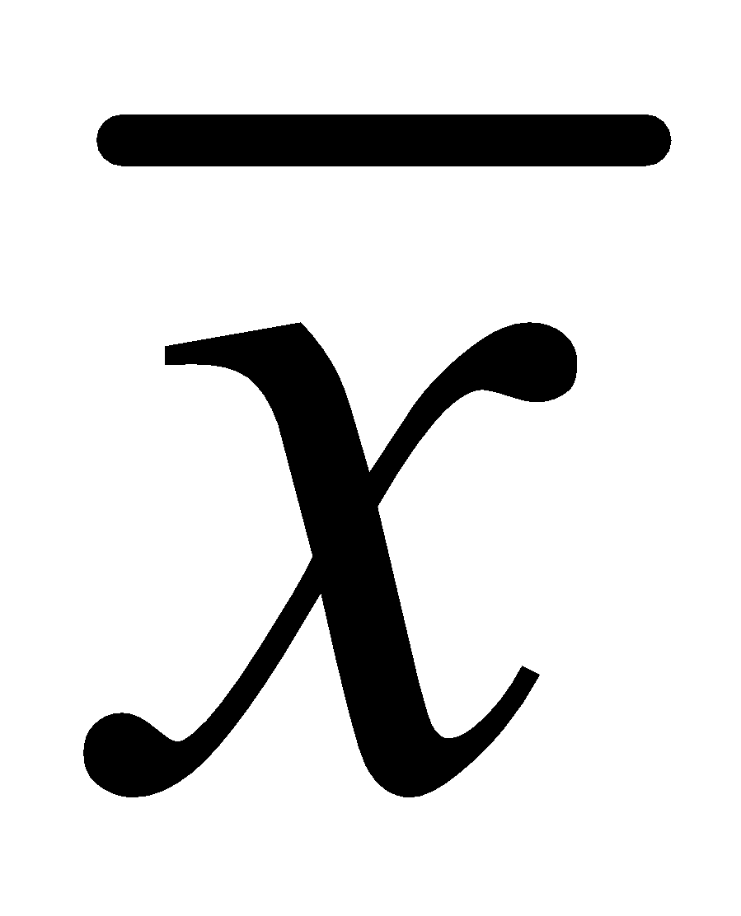
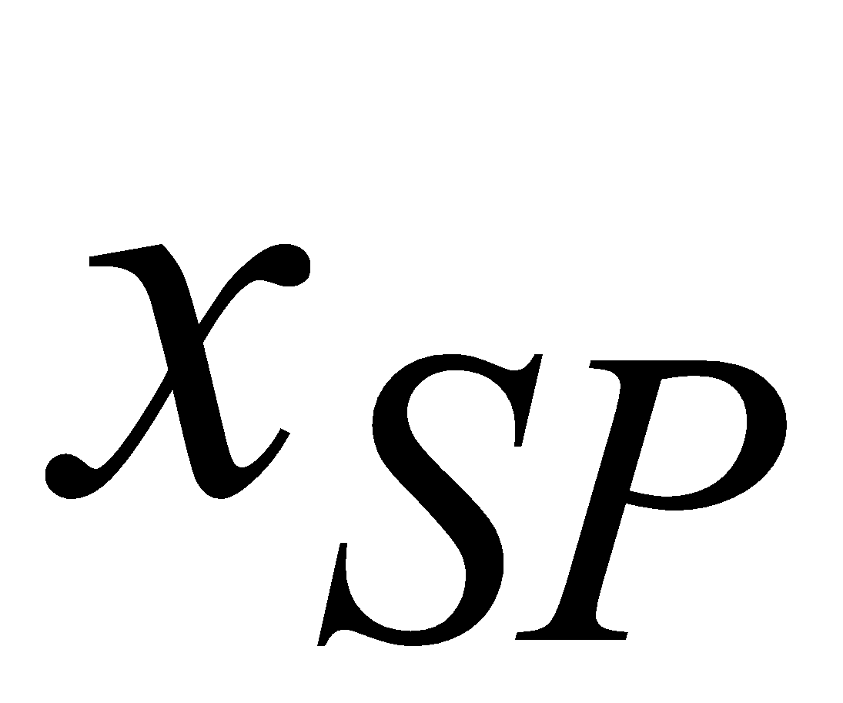
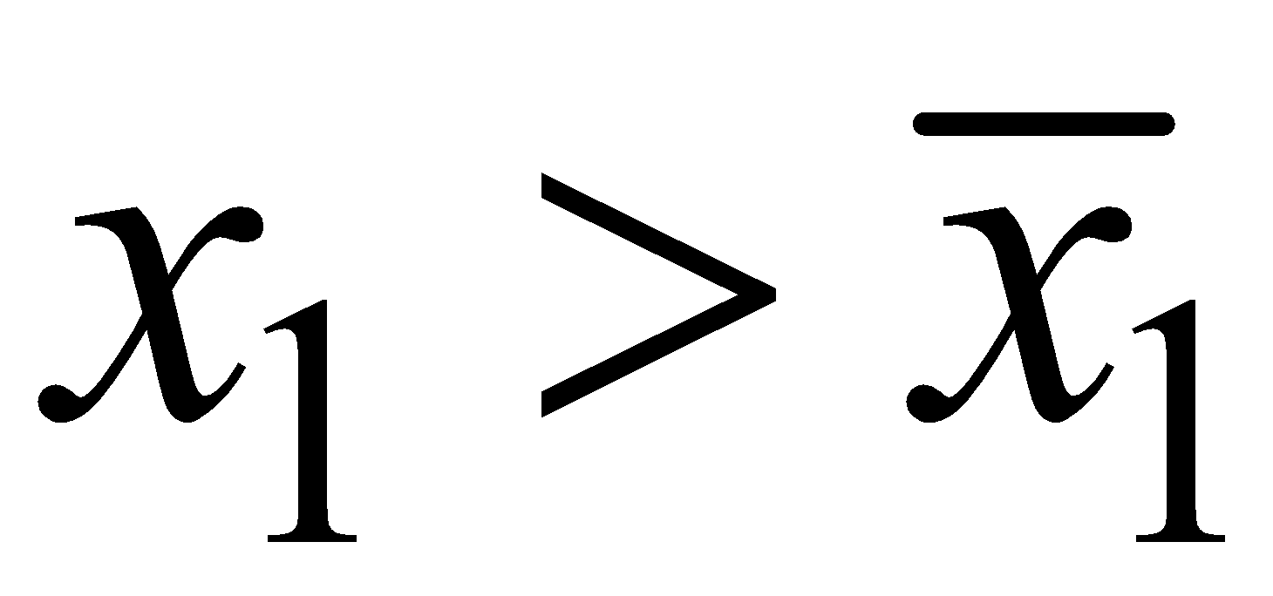
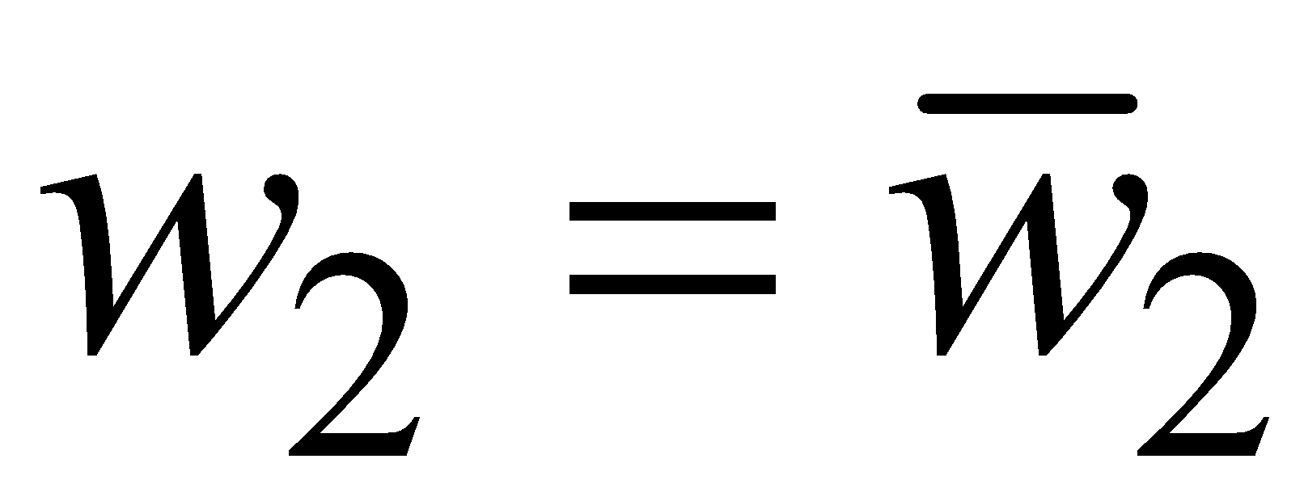
Equation 1-3 is the design equation for the blending system.
If our assumptions are correct, then this value of will keep at . But what if conditions change?
Control Question. Suppose that the inlet concentration x₁ changes with time. How can we ensure that x remains at or near the set point ?
As a specific example, if and , then x > x_{SP.}
Chapter 1
Some Possible Control Strategies:
Method 1. Measure x and adjust w₂.
Intuitively, if x is too high, we should reduce w₂;
‹#›

Slide 12
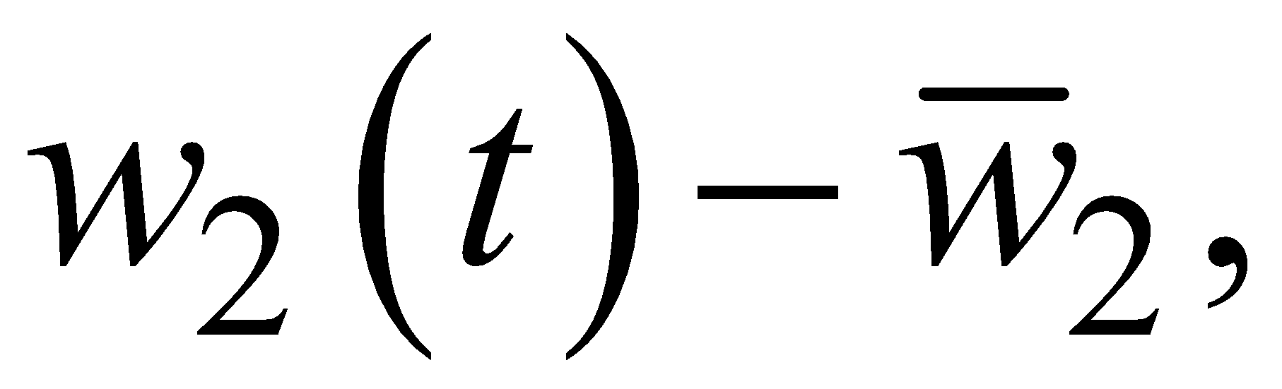
Manual control vs. automatic control
Proportional feedback control law,
where K_{c} is called the controller gain.
w₂(t) and x(t) denote variables that change with time t.
The change in the flow rate, is proportional to the deviation from the set point, x_{SP} – x(t).
Chapter 1
‹#›

Slide 13
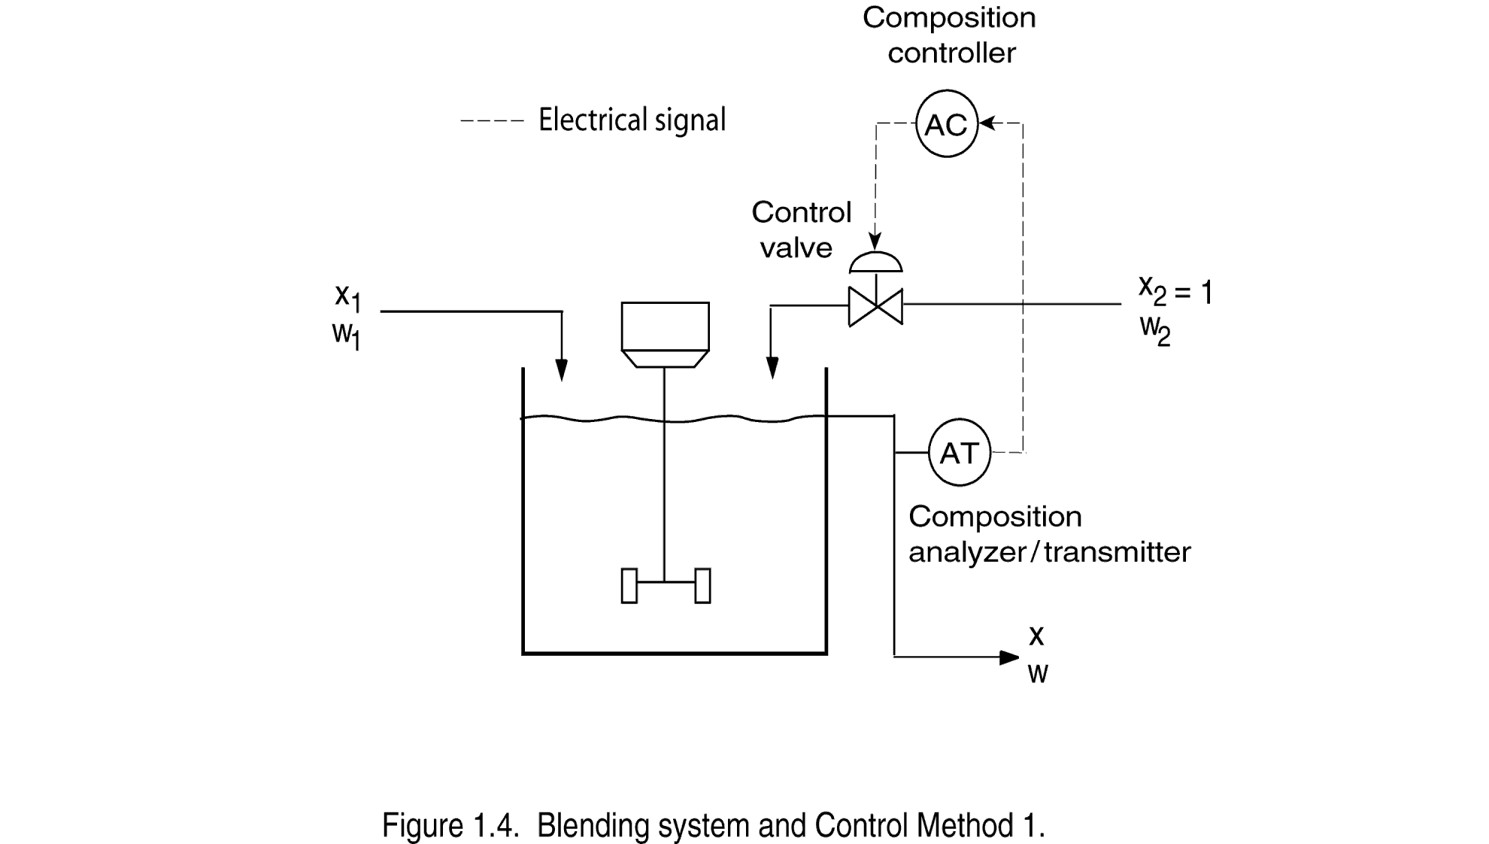
Chapter 1
‹#›

Slide 14
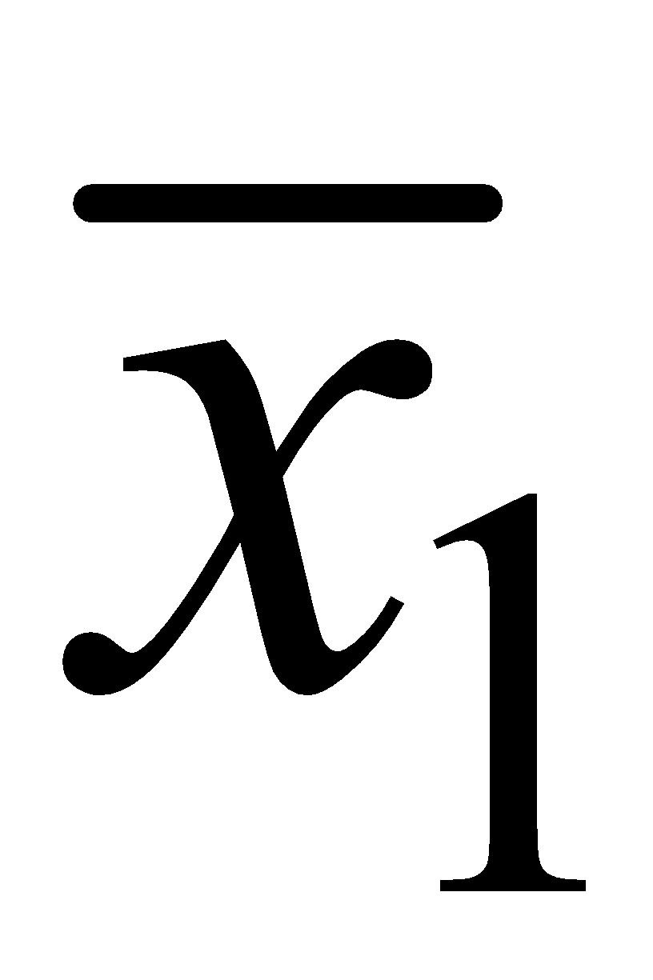
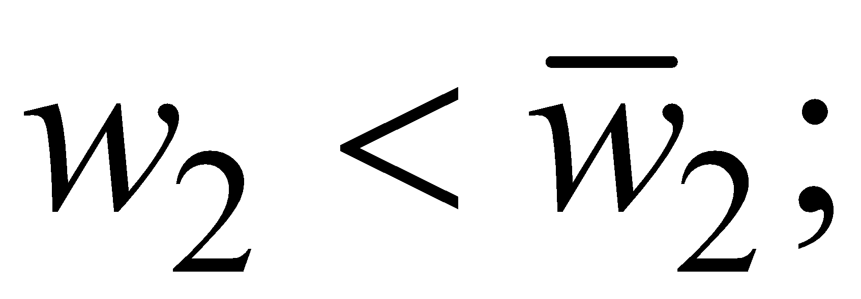
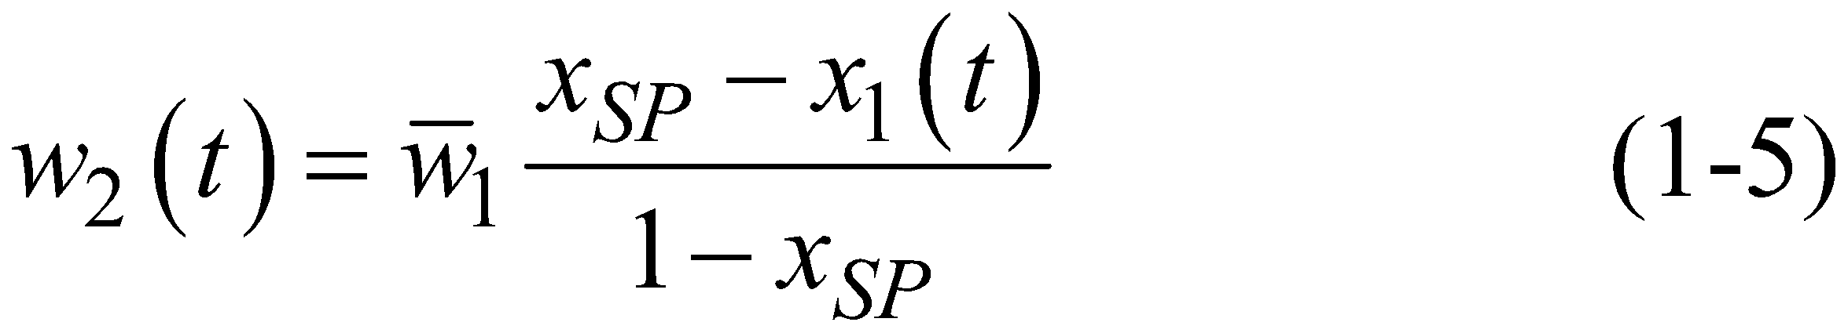
Method 2. Measure x₁ and adjust w₂.
Thus, if x₁ is greater than , we would decrease w₂ so that
One approach: Consider Eq. (1-3) and replace and with x₁(t) and w₂(t) to get a control law:
Chapter 1
‹#›

Slide 15
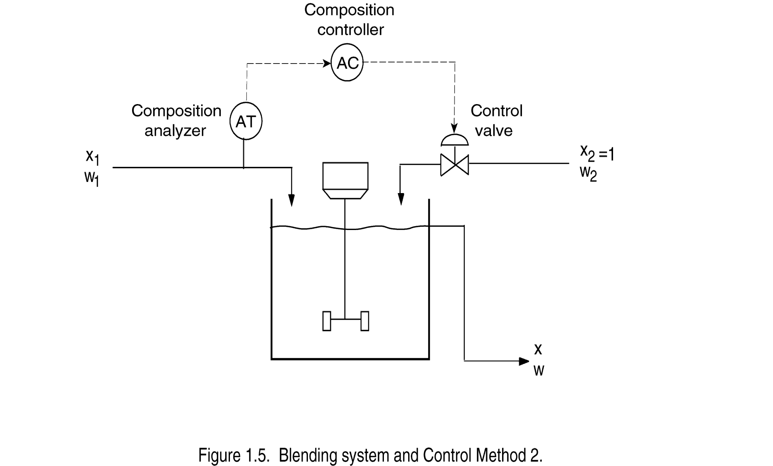
Chapter 1
‹#›

Slide 16
Because Eq. (1-3) applies only at steady state, it is not clear how effective the control law in (1-5) will be for transient conditions.
Method 3. Measure x₁ and x, adjust w₂.
This approach is a combination of Methods 1 and 2.
Chapter 1
Method 4. Use a larger tank.
If a larger tank is used, fluctuations in x₁ will tend to be damped out due to the larger capacitance of the tank contents.
However, a larger tank means an increased capital cost.
‹#›

Slide 17
Classification of Control Strategies
Table. 1.1 Control Strategies for the Blending System
Method | Measured Variable | Manipulated Variable | Category
1 | x | w₂ | FB
2 | x₁ | w₂ | FF
3 | x₁ and x | w₂ | FF/FB
4 | - | - | Design change
Chapter 1
Feedback Control:
Distinguishing feature: measure the controlled variable
‹#›

Slide 18
It is important to make a distinction between negative feedback and positive feedback.
Engineering Usage vs. Social Sciences
Advantages:
Corrective action is taken regardless of the source of the disturbance.
Reduces sensitivity of the controlled variable to disturbances and changes in the process (shown later).
Disadvantages:
No corrective action occurs until after the disturbance has upset the process, that is, until after x differs from x_{sp}.
Very oscillatory responses, or even instability…
Chapter 1
‹#›

Slide 19
Feedforward Control:
Distinguishing feature: measure a disturbance variable
Advantage:
Correct for disturbance before it upsets the process.
Disadvantage:
Must be able to measure the disturbance.
No corrective action for unmeasured disturbances.
Chapter 1
‹#›

Slide 20

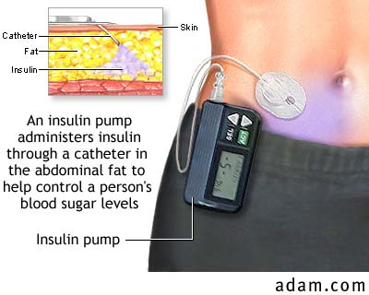

Closed-loop Artificial Pancreas
glucose setpoint
u
y
r
controller
pump
patient
sensor
measured glucose
‹#›

Slide 21
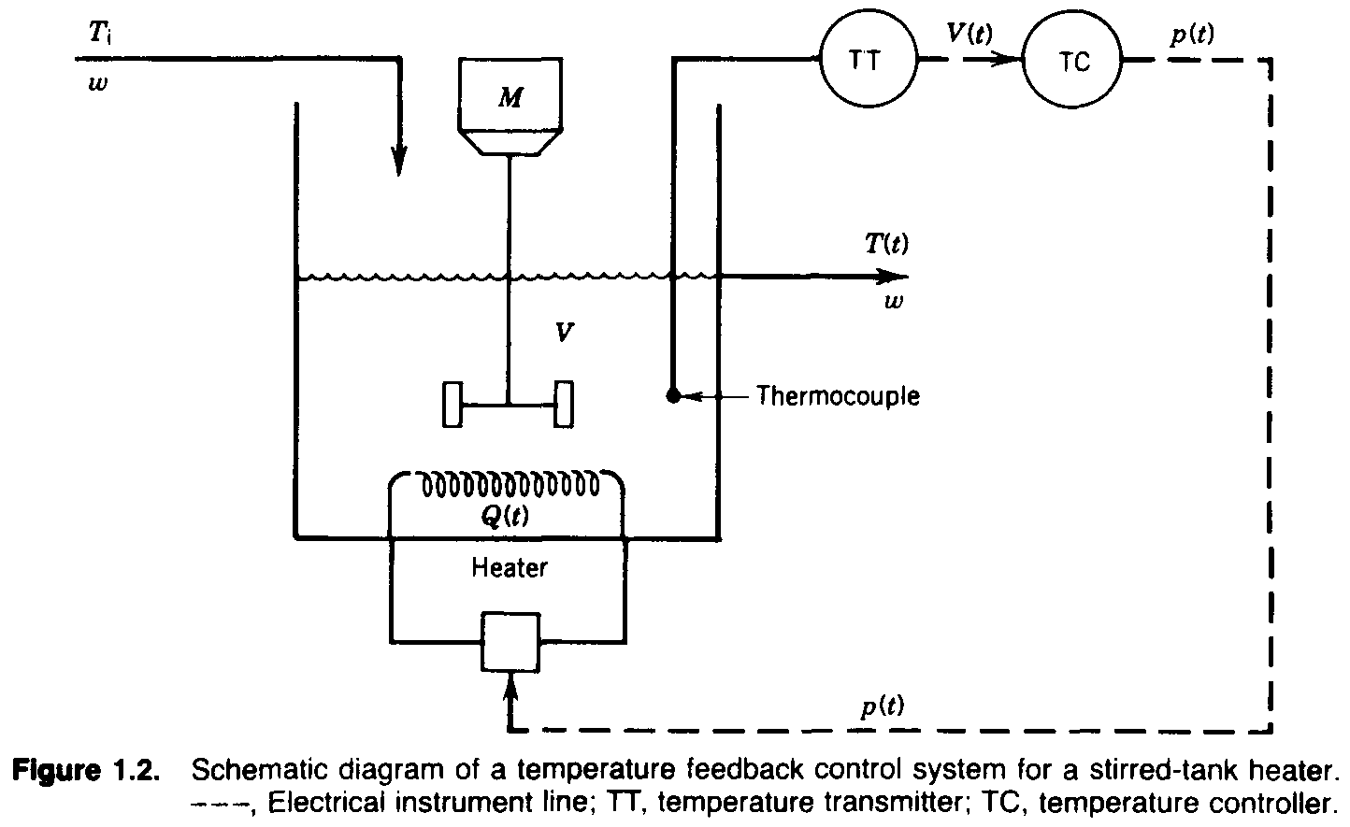
Chapter 1
‹#›
Notes:
‹#›

Slide 22
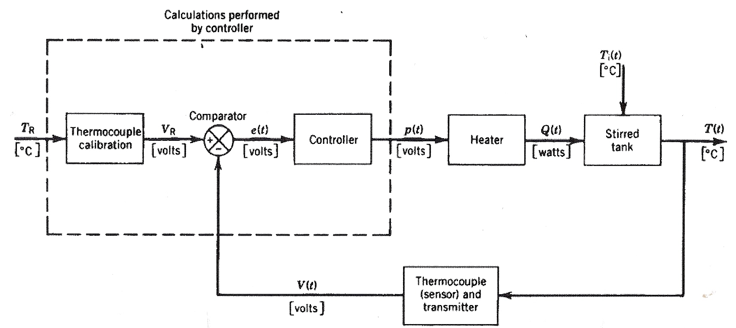
Block diagram for temperature feedback control system
Chapter 1
‹#›
Notes:
‹#›

Slide 23
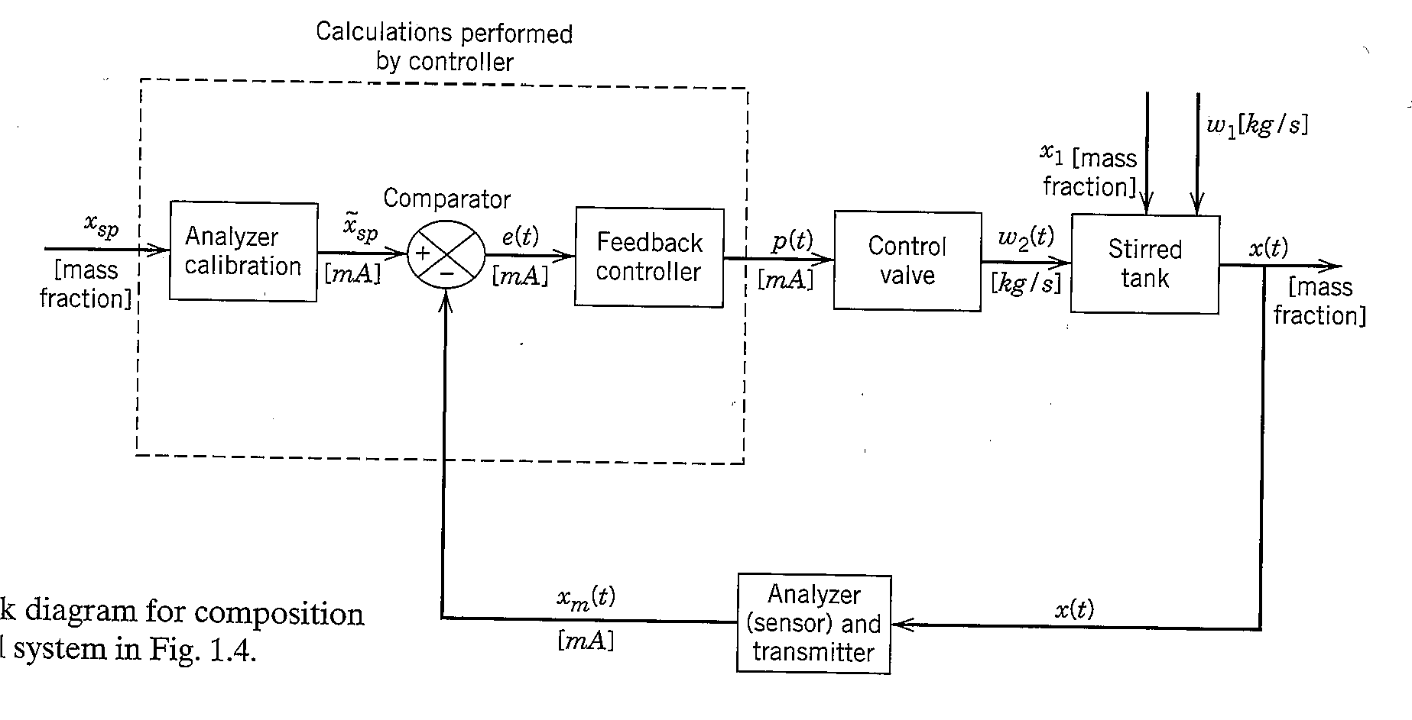
Chapter 1
Figure 1.6 Block diagram for composition feedback control system on Fig. 1.4.
‹#›

Slide 24
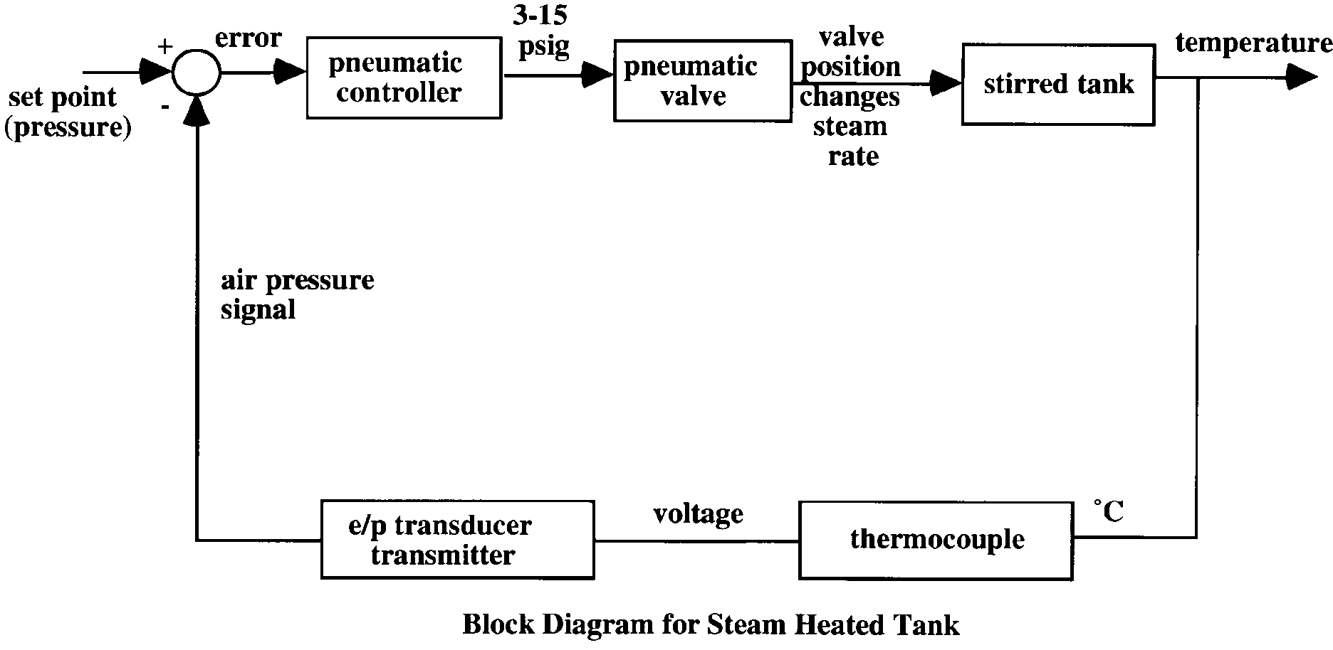
electronic or pneumatic controller
Chapter 1
‹#›
Notes:
‹#›

Slide 25
Justification of Process Control
Specific Objectives of Control
Increased product throughput
Increased yield of higher valued products
Decreased energy consumption
Decreased pollution
Decreased off-spec product
Increased Safety
Extended life of equipment
Improved Operability
Decreased production labor
Chapter 1
‹#›
Notes:
‹#›

Slide 26
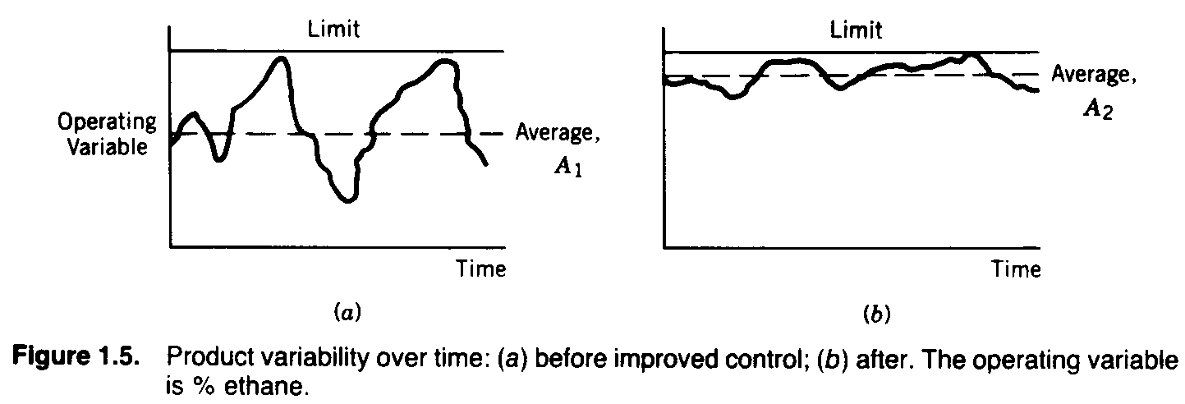
3.2 Economic Incentives - Advanced Control
Chapter 1
‹#›
Notes:
‹#›

Slide 27
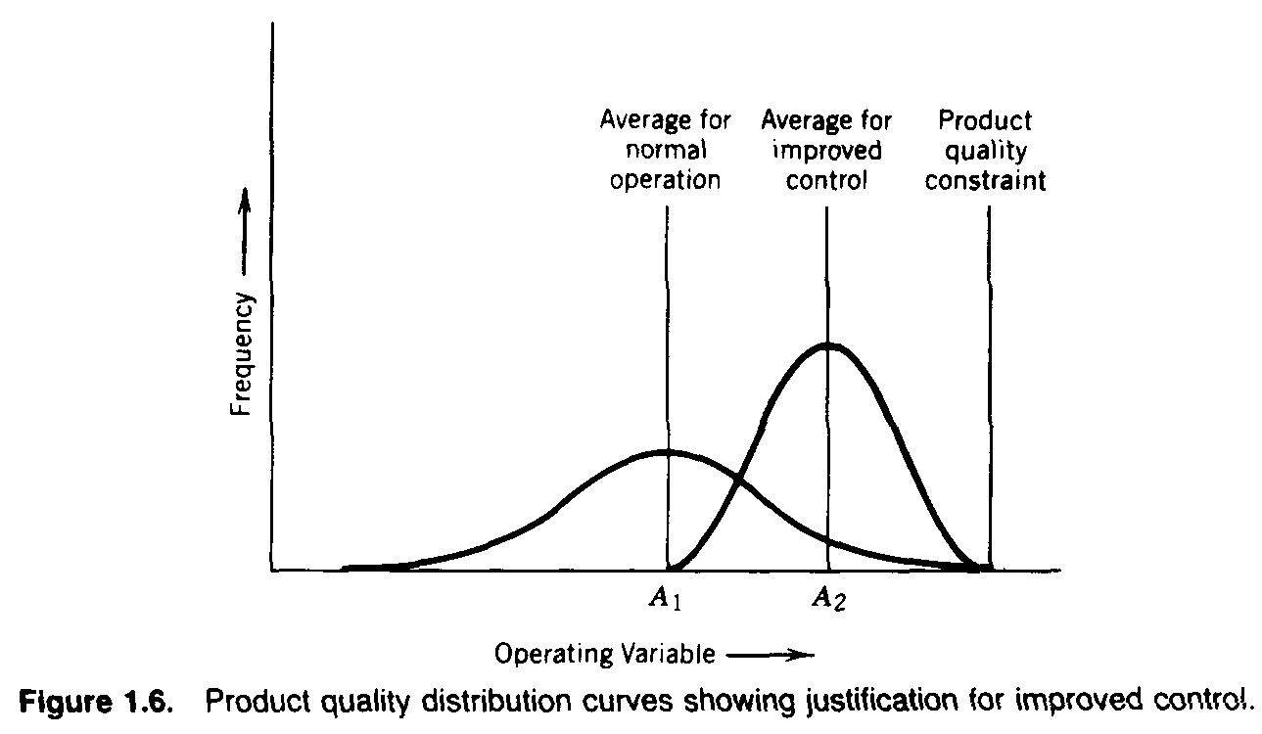
Chapter 1
‹#›

Slide 28
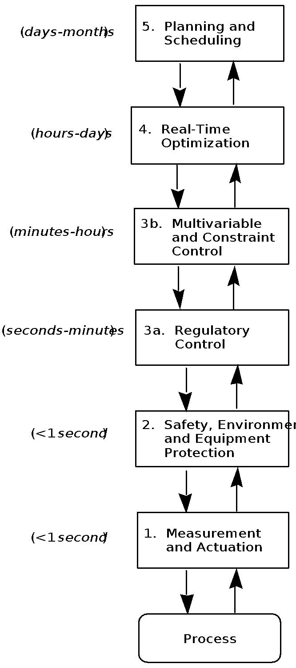
Figure 1.8 Hierarchy of process control activities.
Chapter 1
‹#›
Notes:
‹#›

Slide 29
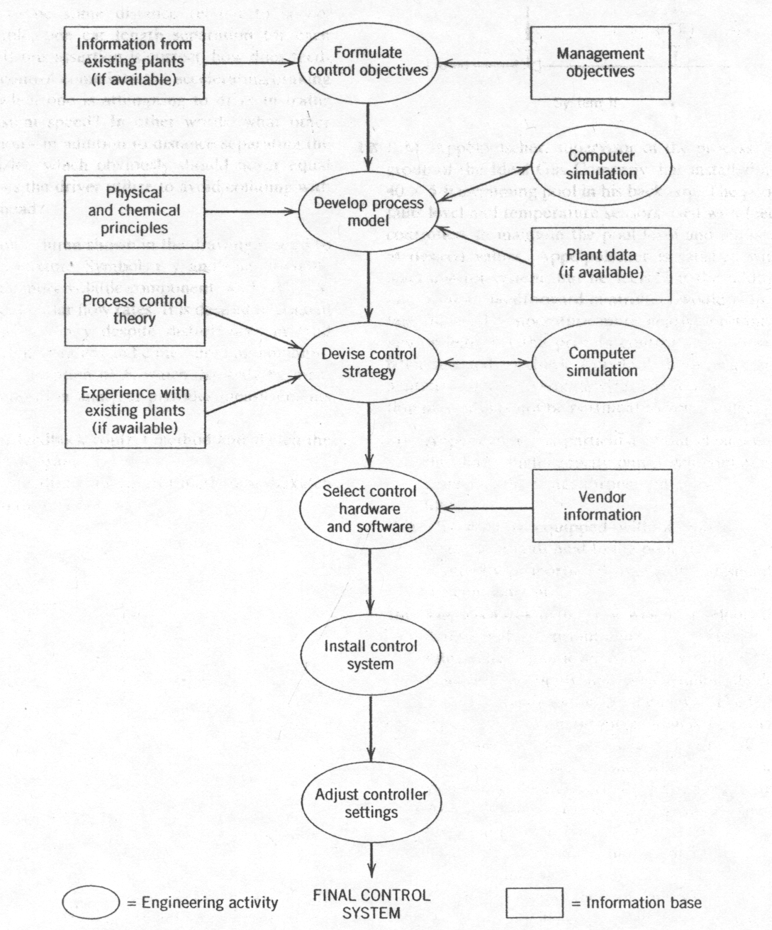
Chapter 1
Figure 1.10 Major steps in control system development
‹#›
Notes:
‹#›

Slide 30
Chapter 1
Next chapter
‹#›
Notes:
‹#›

